Slide 1



Slide 2
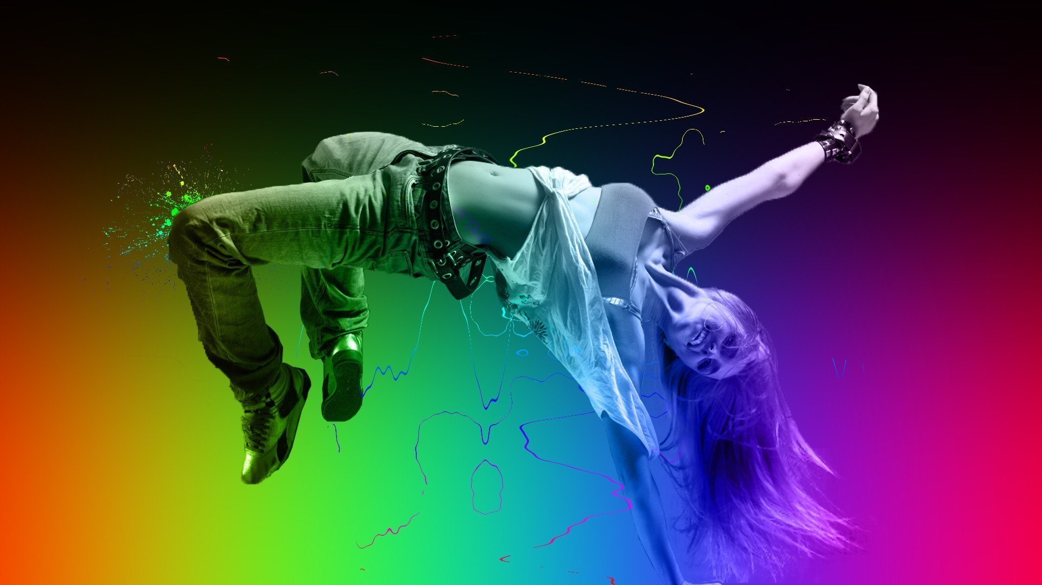
1 S T E P
By Lucy Gardener

Slide 3
Contents
Proposed Designs
Home Page
Classes Page
Contact Us Page
Mobile Pages
Content Management System/Admin Controls
Technical Details
Legal requirements
Pricing
Timeframe for website
Questions
Refrences
Project Proposal
Target Audience
Client Demands
Mood Boards
Website Hierarchy
Technical Considerations
Dynamic vs Static Sites
Accessibility
Ways to Implement Accessibility
Search Engine Optimisation

Slide 4
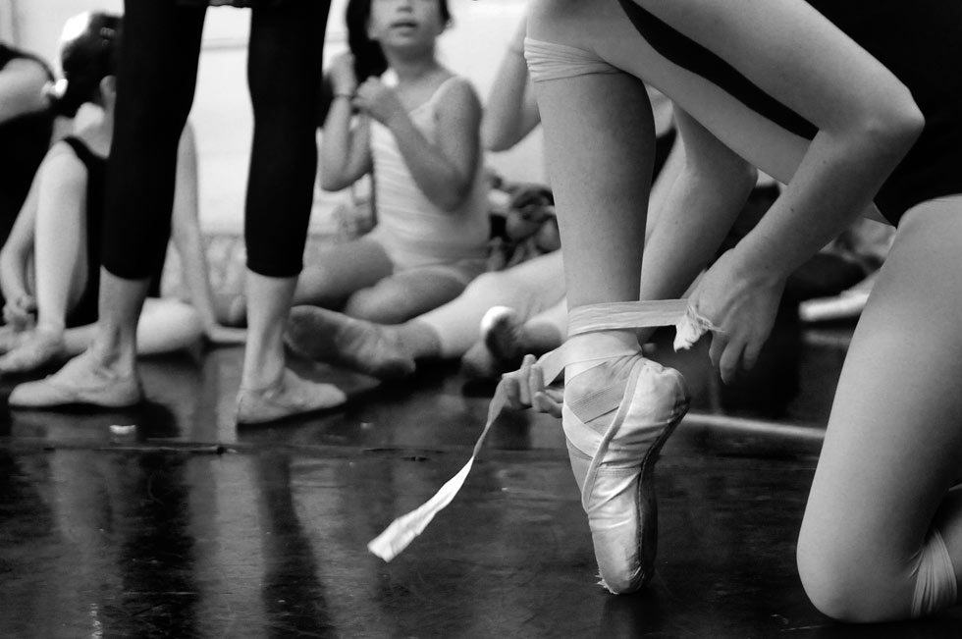
Project
Proposal

Slide 5
Target Audience
1 STEP are a premium contemporary dance studio offering a tuition and training in traditional ballet and abstract dance.
1 STEP offers daily classes, as well as owning a dance studio that individuals and groups can also hire.
Because of this most of the websites main visitors tend ot be professionals; guest shows and groups.
The company do market themselves as a high-end brand, and provides leading facilities.

Slide 6
Client Demands
As 1 STEP are a high-end premium contemporary dance studio, and they have professional clientelle they would like their site to:
Be professional
Include links to common social media
Must be responsive so it works on a lot of different devices

Slide 7
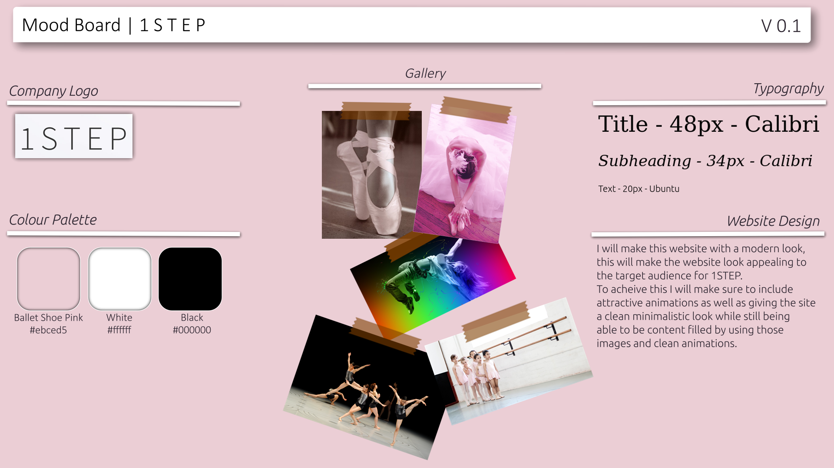
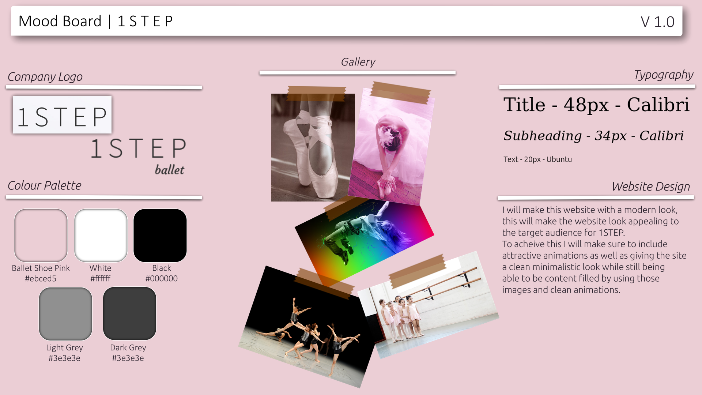
MoodBoards

Slide 8
Website Hiearchy
Home
Classes
Contact Us
Gallery
About
Admin Login
User Management
Content Management

Slide 9

Technical
Considerations

Slide 10
Dynamic vs Static Sites
Dynamic websites are “database-backend sites with dynamically generated content” (O’Reilly, 2007, p.18)
This means that all/some users can see different data/information on the site. This can be dynamically updated and (relatively) easy to chage/update by admins

Slide 11
Accessibility
Accessibilty is a very important thing to consider when building a website.
You want anyone to be able to access/use your site and that means you have to make it accessible even if they have disabilities or impairments that could make it difficult for them to be able to use the web
As said in the book a book about web accessibilty (Rutter, R. et al., 2006 p.2) “Web accessibilty means that people with disabilities can percieve, understand, navigate and interact with the web.”
Web accessibility is about removing those barriers so that everyone can use and contribute to the web (Rutter, R. et al., 2006 p.2) or someones website.
While it is very important to include things in your site to be able to make your website more accessible it is also important to remember that people will have a lot of tools already to help them so it is better not to over-engineer anything, while at the same time making it easy for those devices to do their jobs.

Slide 12
Ways to Implement Accessibility
There are numerous ways to implement accessibility on a website.
Some examples of this stated by the acrticle made by the W3 consortium (w3.org, 2017) are:
Easy-to-read text : This is important as it means passages of text can be easier to understand
Symbols : Icons can be used to represent words or concepts making it easier for people who find it more difficult to read or write
Reduced interface : only shows content that is releevant and not repeated, can also hide content that could distract users
Customised fonts and colours : Changing the font types, sizes and colors, and spacing to make text easier to read.
Consistency and predictability : labelling of functions such as links, buttons and controls should be consistent and the expected function should be predicabale from the label.
Descripting titles, headings, and labels : Page titles, section headings, and labels for forms, links, and controls are sometimes read on their own or out of context and need to be descriptive

Slide 13
Ways to Implement Accessibility
Alt Tags
Images that play some active role in the navigation of a site must have meaningful and simple alt-text. Users with disabilities will not be able to navigate or otherwise interact with your site without that text. (Rutter, R. et al., 2006 p.136)
Alt text allows a screen reader to read to a screen reader user what is trying to be conveyed on the website page however when there is not alt-text, different assistive technologies look in different places such as the src/href of an image which at time can be really unreliable and not helpful for a screen reader user.

Slide 14
Search Engine Optimisation (SEO)

Slide 15
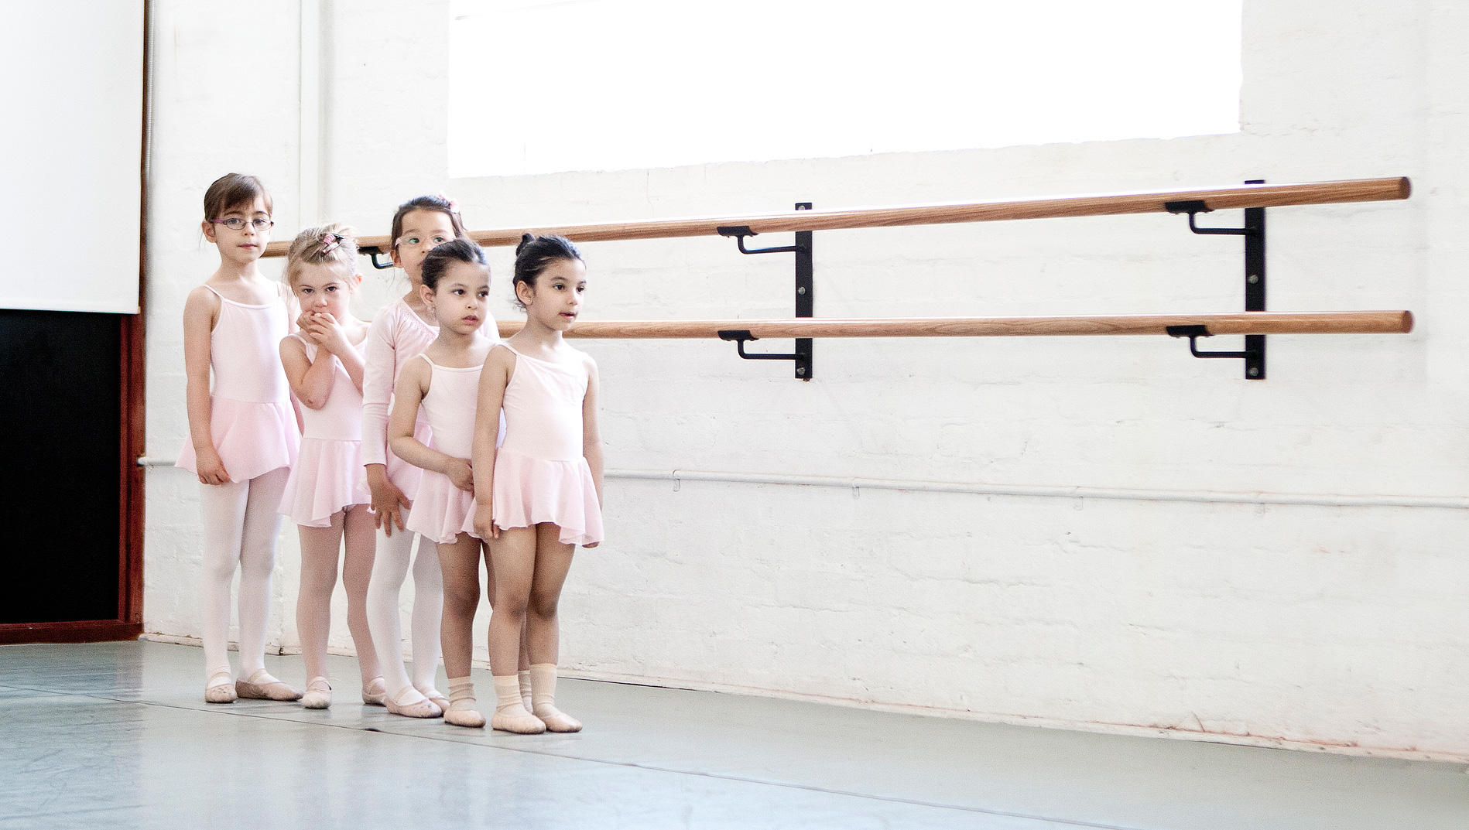
Proposed
Designs

Slide 16
Home Page

Slide 17
Classes Page

Slide 18
Contact Us Page

Slide 19
Mobile Pages

Slide 20
Content Management System/Admin Controls

Slide 21
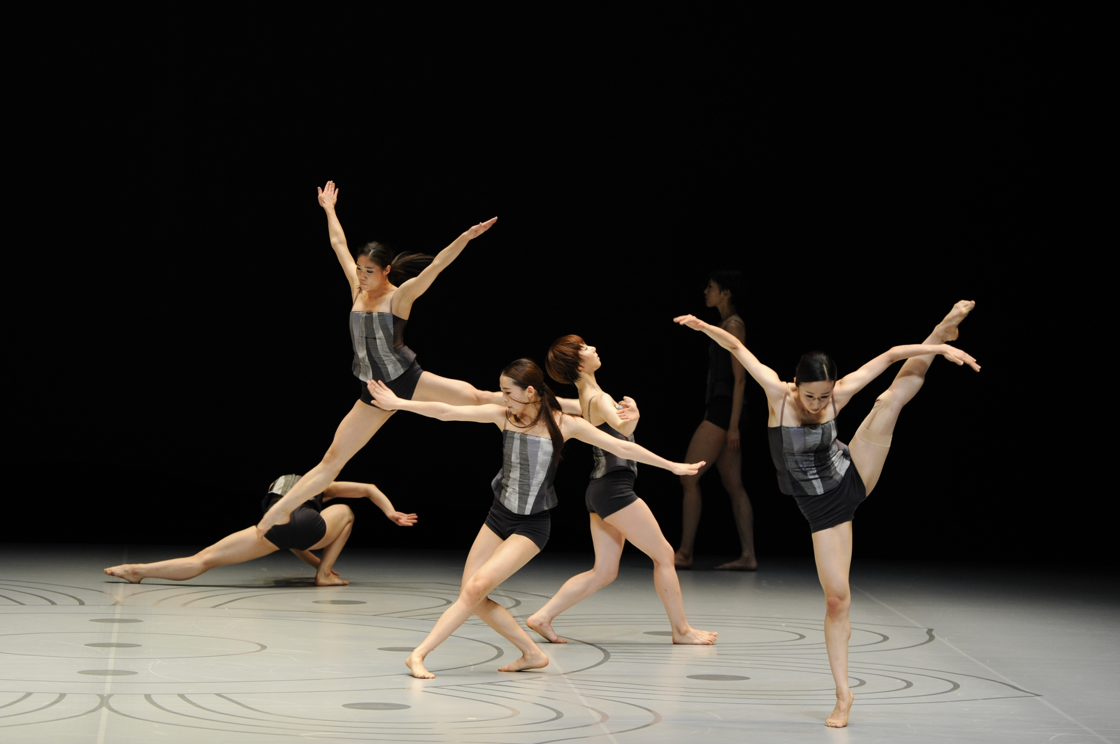
Technical
Details

Slide 22
Legal Requirements

Slide 23
Pricing

Slide 24
Timeframe for Website

Slide 25

Questions

Slide 26
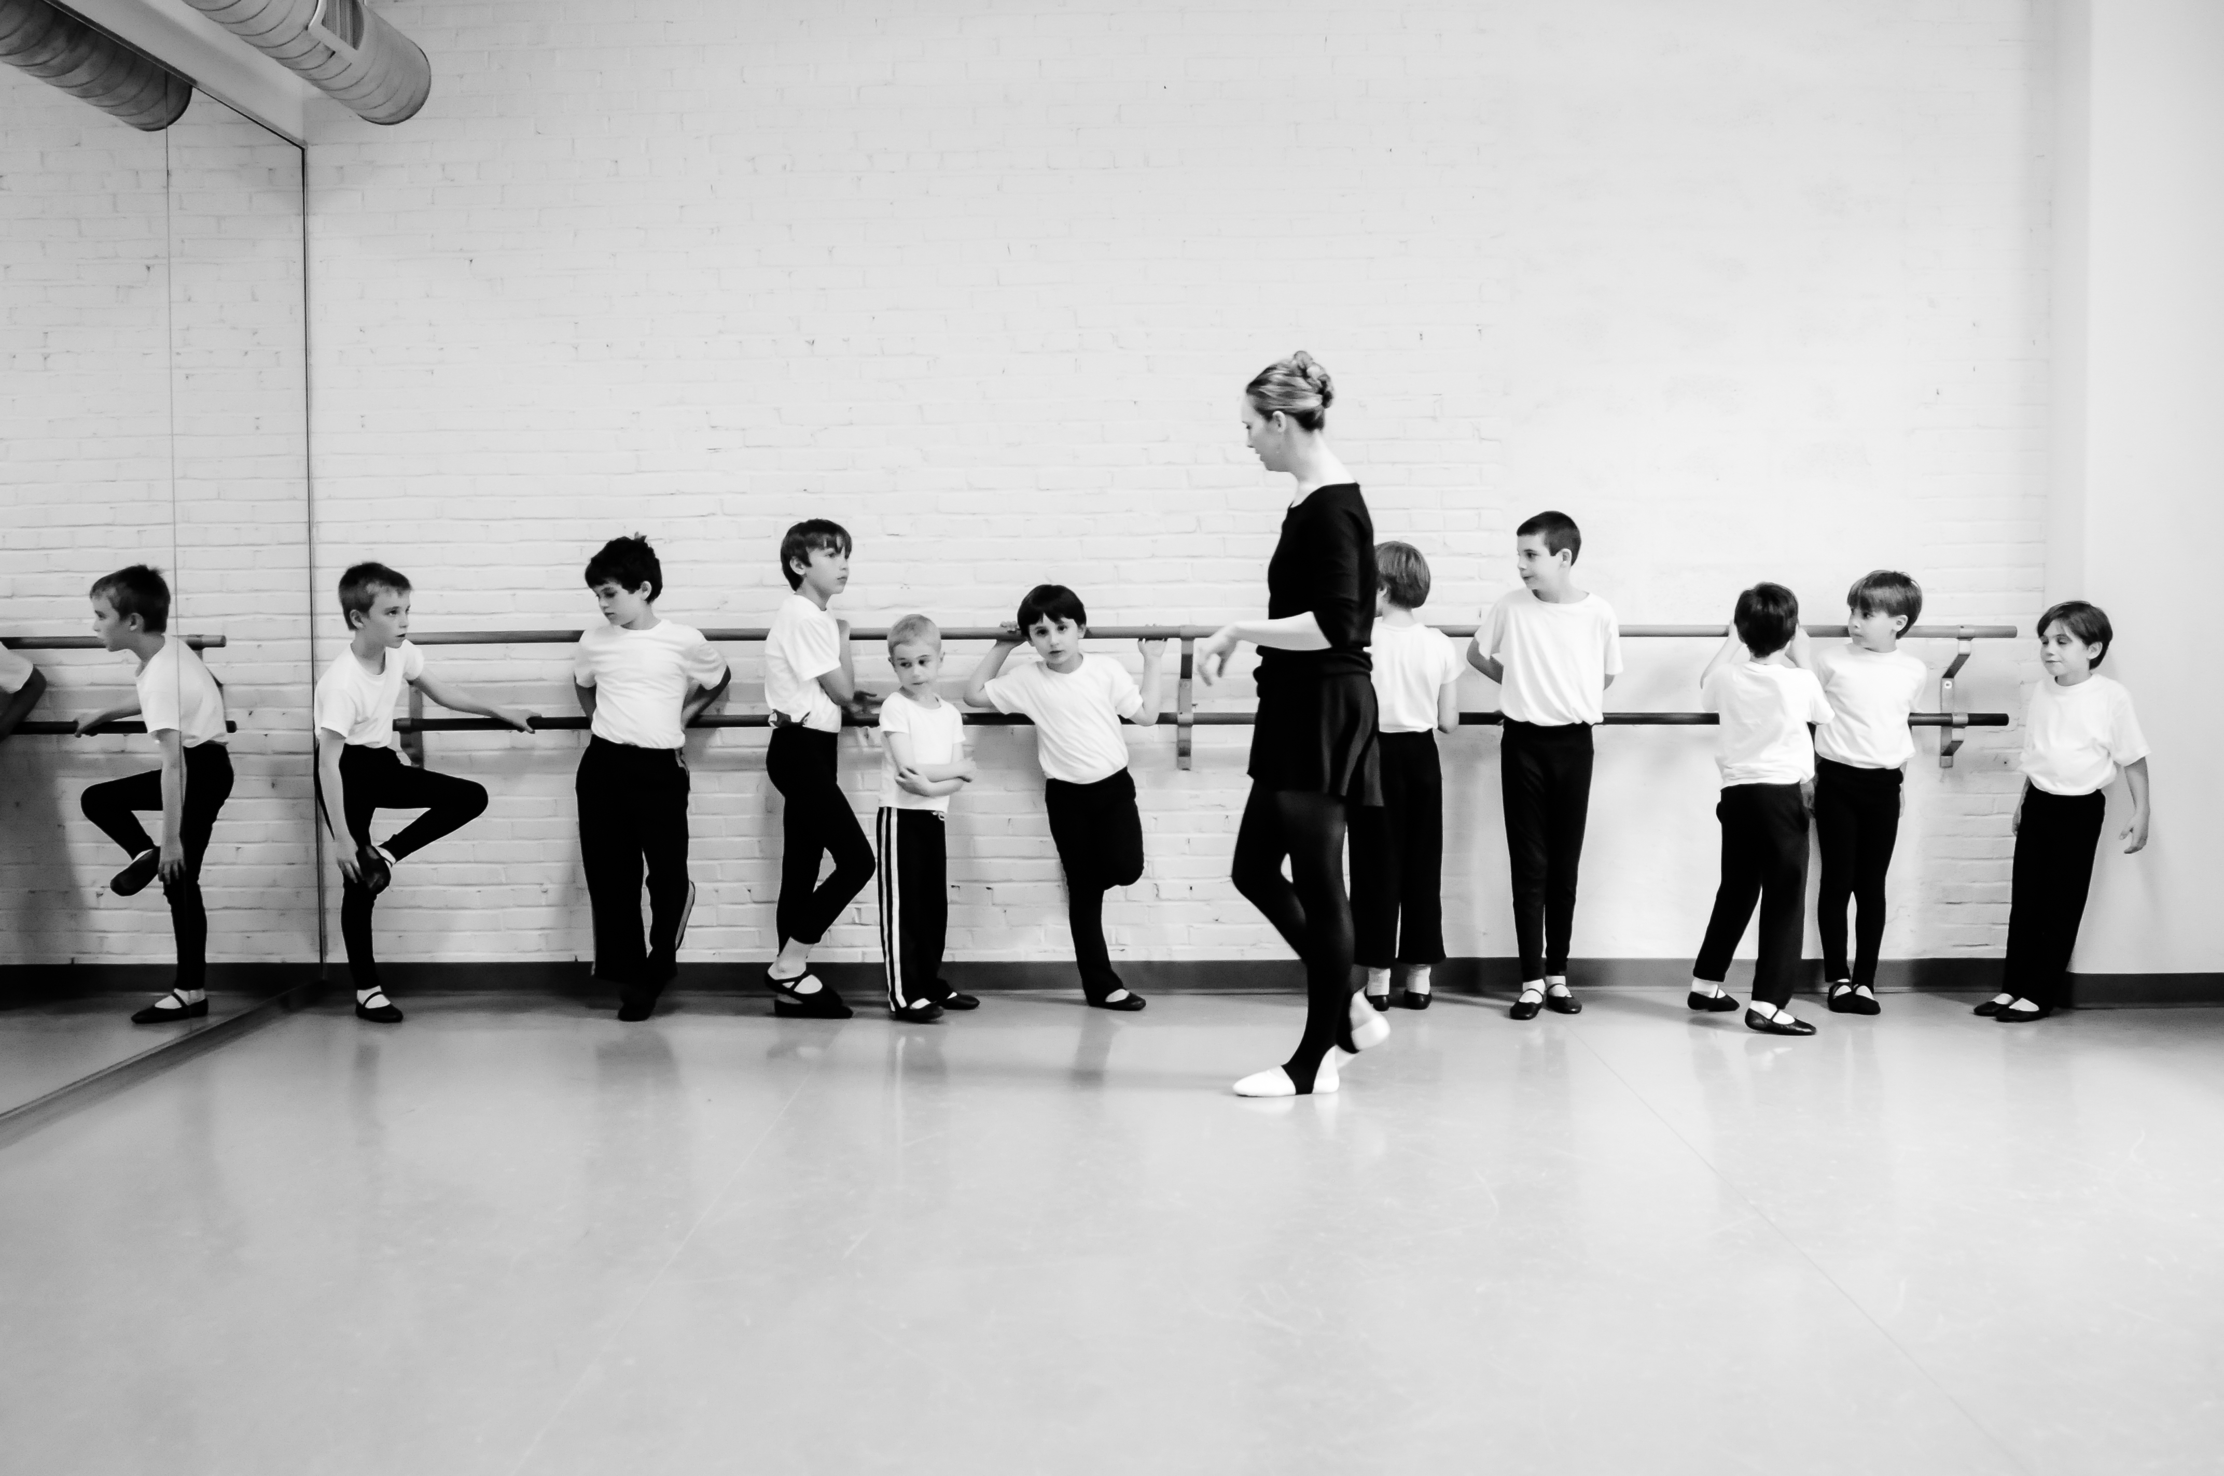
Refrences

Slide 27
O’Reilly, T. (2007) What is Web 2.0: Design Patterns and Business Models for the Next Generation of Software [online]. SSRN: O'Reilly Media, Inc. [Accessed 18 11 2022].
Rutter, R. et al. (2006) Web accessibility web standards and regulatory compliance. Berkeley, CA: Apress. [Accessed 18 11 2022].
Tools and Techniques (2017) w3.org [online]. 15 May. Available from: https://www.w3.org/WAI/people-use-web/tools-techniques [Accessed 20 11 2022].

